Slide 1

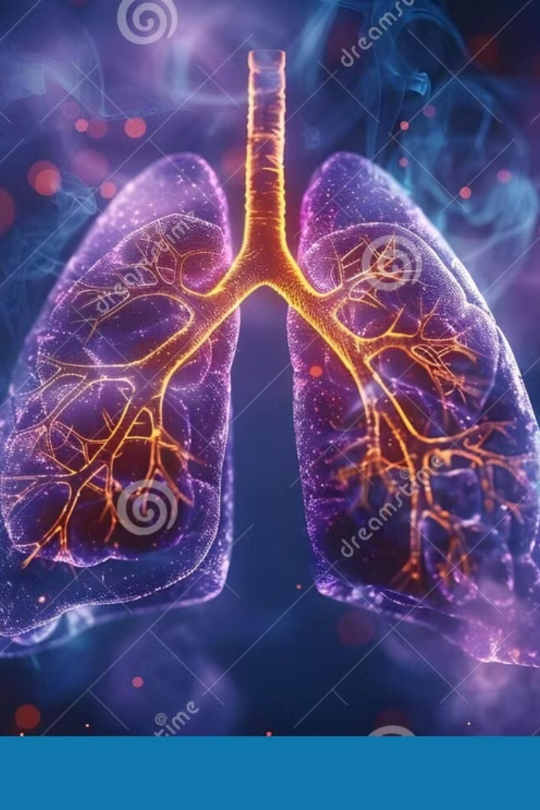


Lung Cancer Surveillance and Outcomes Analysis Using Global Data for Local Insights
This project investigates patterns and outcomes of lung cancer using global datasets to inform local health decisions. Through advanced data visualization and analysis, the project uncovers how factors like gender, age, smoking behavior, and diagnostic timing affect lung cancer prevalence and survival. The insights aim to bridge global data with Kenya's public health challenges—especially in underserved regions where access to early detection and treatment is limited.
by Nathan
Notes:
1

Slide 2

Target Audience & Problem Statement
Target Audience
Problem Statement
Kenyan health policy makers
Lung cancer remains one of the deadliest forms of cancer globally, with limited local data available in many developing regions, including Kenya. Decisions on early detection, screening, and treatment allocation are often made without sufficient data-driven guidance. This project bridges that gap by transforming global cancer data into meaningful health indicators, revealing the urgent need for more localized strategies to combat lung cancer effectively.
Public health researchers
Oncology program managers
Community health organizations
Data-driven medical students and researchers
These insights are vital to this audience because they highlight critical intervention points—like smoking cessation, improved screening access, and targeted treatment strategies—that could significantly lower lung cancer burden and improve outcomes in Kenya.
Notes:
2

Slide 3
Survival & Diagnosis Rates
6
4.06%
28.37%
Average Survival Years
Diagnosis Rate
Early Detection Rate
The average survival post-diagnosis is approximately 6 years. This relatively optimistic figure suggests that earlier diagnosis, especially in certain subtypes, can improve life expectancy.
Around 4% of the cohort were diagnosed with lung cancer. This figure, although lower than global averages, reflects a general population and not just high-risk groups.
Less than a third of patients are diagnosed at an early, treatable stage. Early detection significantly increases survival chances.
Local solutions include introducing and promoting early detection methods in rural counties, focusing screening efforts on at-risk populations (e.g., smokers aged 60+), and expanding access to CT screening in county referral hospitals. The diagnosis rate is lower than GLOBOCAN's 11.4% because the dataset includes non-cancer individuals. The gap in early detection stems from low screening rates and limited awareness among high-risk populations.
Notes:
3

Slide 4
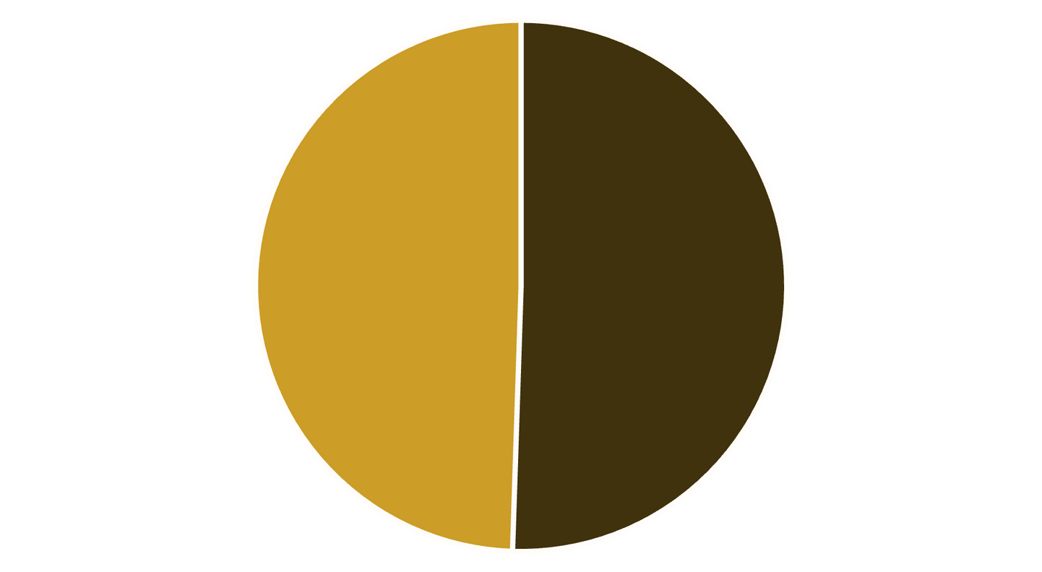
Gender Prevalence & Stage-Wise Diagnosis
Contrary to past data where lung cancer was viewed as a men's disease, gender differences in lung cancer is narrowing. Rising smoking rates among women and declining rates in men are closing the gender gap. This finding suggests the need to design gender-balanced prevention and education programs.
Stage-wise diagnosis differences show that Stage 4 diagnoses are 15.55% higher than baseline, while Stage 2 and 3 are underrepresented. This matters because most patients present too late for curative treatment. The local solution would be to improve symptom awareness campaigns to encourage early medical visits. Late presentation may result from delayed symptom recognition, poor access to care, or cultural factors around health-seeking behavior.
Male
Female
Contrary to past data where lung cancer was viewed as a men's disease, gender differences in lung cancer is narrowing. Rising smoking rates among women and declining rates in men are closing the gender gap. This finding suggests the need to design gender-balanced prevention and education programs.
Stage-wise diagnosis differences show that Stage 4 diagnoses are 15.55% higher than baseline, while Stage 2 and 3 are underrepresented. This matters because most patients present too late for curative treatment. The local solution would be to improve symptom awareness campaigns to encourage early medical visits. Late presentation may result from delayed symptom recognition, poor access to care, or cultural factors around health-seeking behavior.
Notes:
4

Slide 5
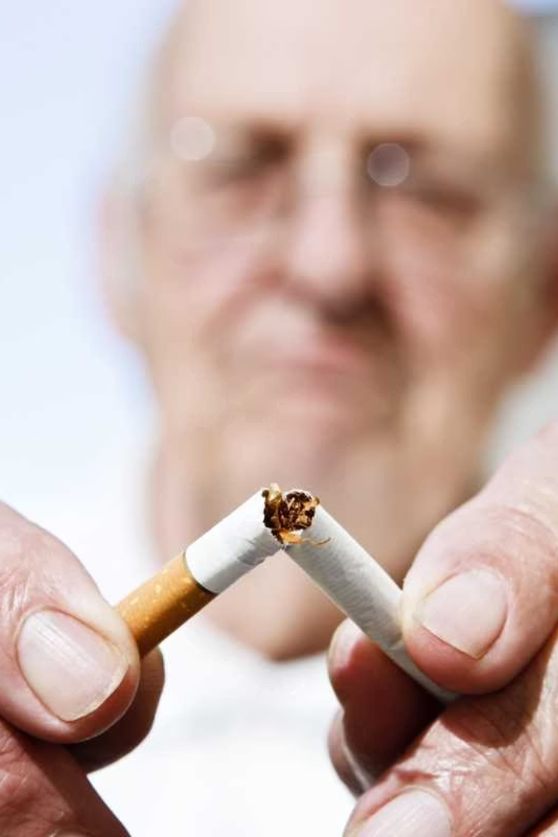



Smoking Status & Age Group Analysis
Diagnosis by Smoking Status
Smokers, although a smaller share of the population, account for the most diagnoses. Strong correlation between smoking and cancer risk justifies intensified anti-smoking efforts.
Smoking Prevalence by Age Group
Highest among 65–70, lowest in 85–90. Age-tailored interventions can reduce future lung cancer risk.
Local Solutions
Enforce tobacco regulation laws and introduce cessation support in primary care. Run tobacco education and quitting programs for people aged 60–70.
Smokers have 8–14× higher risk; even passive smoking raises risk by 30%. Smoking drops sharply in older age due to mortality, health complications, or voluntary quitting.
Notes:
5

Slide 6

Treatment Differences by Gender
Men's Treatment Patterns
Women's Treatment Patterns
Men more often receive surgery as a primary treatment option for lung cancer.
Women receive radiotherapy more frequently than men.
Higher rates of surgical intervention
Higher rates of radiation therapy
Different comorbidity profiles
Potentially different tumor subtypes
Potentially different tumor characteristics
Different presentation patterns
Local Solution
Promote equitable access to surgery and diagnostics for both genders.
Gender-sensitive treatment protocols
Equal access to advanced diagnostics
Personalized treatment planning
Treatment customization can improve survival outcomes. Differences may stem from underlying health, comorbidities, or biological tumor traits.
Notes:
6

Slide 7
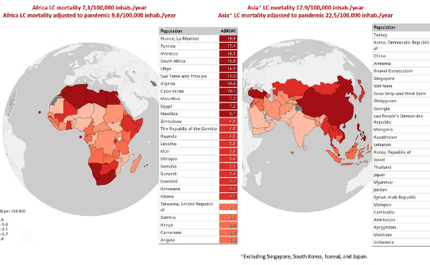
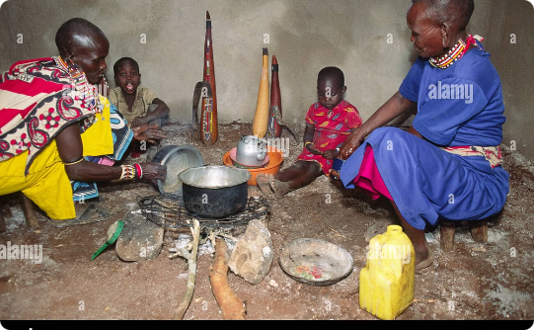
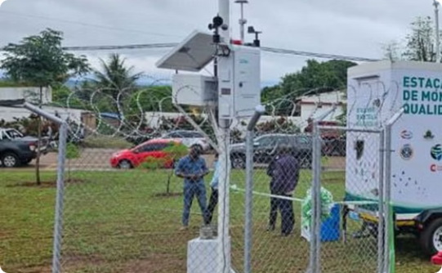
Geographic Prevalence & Risk Factors
Regional Prevalence
Environmental Risk Factors
Monitoring Solutions
Highest lung cancer prevalence in Ethiopia, followed by South Asia. Neighboring regional trends provide early warning for Kenya.
Ethiopia's rural populations use indoor biomass fuels, increasing exposure to carcinogens. Similar patterns may exist in rural Kenya.
Monitor high-risk environments (e.g., urban air quality, indoor pollution) to reduce exposure to lung cancer risk factors.
Understanding geographic patterns helps identify environmental risk factors that may be present in Kenya, allowing for targeted interventions in high-risk areas.
Notes:
7

Slide 8





Recommendations & References
Expand screening using low-dose CT
Especially in counties with tertiary hospitals
Implement tobacco cessation support
In all counties for people aged 60–70
Promote early symptom awareness
In men and women equally
Strengthen rural health facilities
To manage early-stage diagnosis and surgical cases
Monitor air quality
And regulate biomass fuel exposure in rural homes
References: GLOBOCAN 2020 – Global Cancer Observatory, SEER Program – National Cancer Institute, Mount Sinai Health System, American Lung Association, Cancer Research UK, WHO Cancer Projections 2050, JAMA Oncology, Guardian Health Reports, UICC – Union for International Cancer Control
Notes:
8

